Slide 2
Responsible AI
Preet Kanwal
Lecture 2: Robustness

Slide 3
Robustness
Model to maintain the performance when faced with uncertainties or adversarial conditions
Model should generalize well and provide reliable predictions
Handling noisy data, distribution shifts, adversarial conditions
https://medium.com/@slavadubrov/understanding-machine-learning-robustness-why-it-matters-and-how-it-affects-your-models-5e2cb58382dab

Slide 4
Robustness
Transition from AI Risks to Robustness, through Risk Decomposition Black Swans Distribution Shifts Methods to deal with distribution shifts and black swans

Slide 5
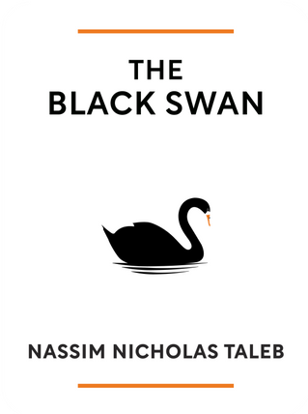
Black Swans
Black Swans Long Tailed Distributions Mediocristan and Extremistan Unknown Unknowns
4

Slide 6
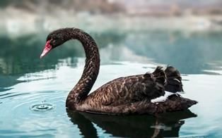
Black Swans
Events that are outliers, lying outside typical expectations, and often
carry extreme impact
Europeans widely assumed swans were only
white, until explorers eventually discovered
black-colored swans in Australia
While often ignored as outliers, Black Swans are costly to ignore since
these events often matter the most

Slide 7
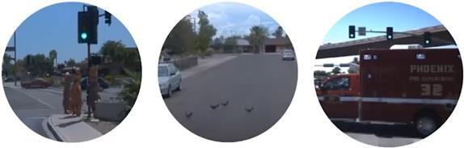
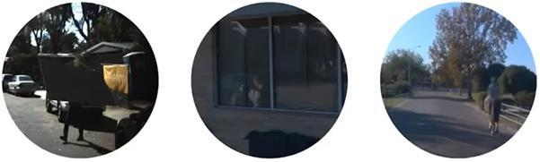
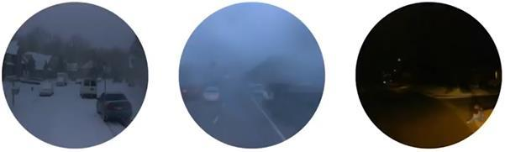

Black Swans

Slide 8

Black Swans
Tilted, occluded, by lights, etc.
2008 financial crisis – I graduated (with PhD) around this
COVID 19
https://arxiv.org/pdf/2109.13916.pdf

Slide 9
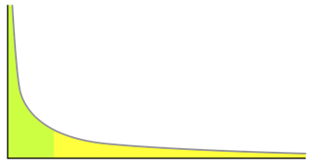
Long Tail Distributions
A tail of a distribution is the region that is far from the head or center of the distribution
Head
Long Tail
Tailstaperoffgraduallyratherthandrop off sharply
Pareto principle / 80-20 principle

Slide 10
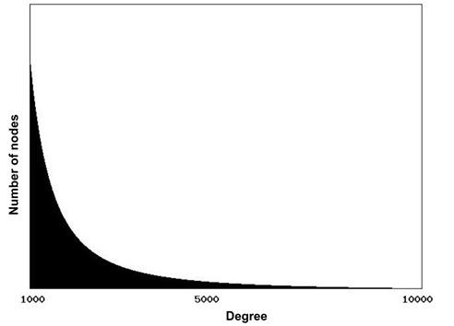
Power Law Distributions are “Scale Free”
The Web’s Approximate Degree Distribution

Slide 11
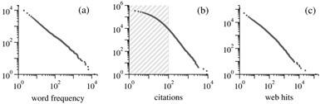
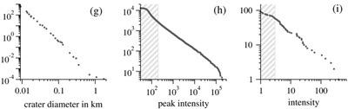
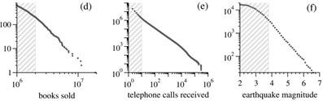
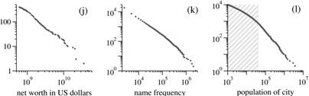
Long Tails Are Pervasive

Slide 12
Long Tails Are Pervasive
~0.1% of drugs generate a~50%pharmaceutical industry sales
~0.2% of books account ~50% their sales
~1%ofbands and solo artists earn~77% of all revenue from recorded music

Slide 13
Nonlinear Interactions Generate Long Tails
The result is a long-tailed, but it would be a thin-tailed Gaussian if variables were added instead of multiplied
Nonlinear interactions arise when parts are connected or
interdependent
If the observation becomes zero when a part becomes zero →
nonlinear interaction
Research output = Ideas X Time X Students X Resources

Slide 14
Mediocristan and Extremistan
Mediocristan
Thin tails
Total is determined by many small events
Typical member mediocre/average Tyranny of the collective Top few get small slice Easy to predict
Impact nonscalable
Mild randomness
Extremistan
Long tails
Total is determined by a few large events
“Typical” member giant or dwarf
Tyranny of the accidental Top few get large share Hard to predict
Impact potentially scalable
Wild randomness

Slide 15
Unknown Unknowns
Known Knowns Unknown Knowns
Things we are aware of and understand Things we understand but are not
We know what we know
aware of
We don’t know that we (can) know
Unaccounted facts / Tacit knowledge Self-analysis
Facts and requirements Recollection
Known Unknowns Things we are aware of but don’t understand
We know that we do not know these
Known classic risks / Conscious
ignorance
Closed-ended Questions
Unknown Unknowns Things we are not aware of nor understand
We don’t know what we don’t know
Unknown risks / Meta-ignorance
Open-ended Exploration

Slide 16
Black Swans, Unknown Unknowns, and Long Tails
Black Swan events are rare but highly impactful and often appear in long-tailed distributions, which dominate risk analysis.

Slide 17
Black Swans and Long-Term Safety
AI’s eventual impact on the world may be long-tailed
We want models that can withstand and detect Black Swans, which are more likely to arise in the future when the world is changing rapidly and unexpectedly
If we have multiple AI agents deployed in the future, and if the social power or command over resources is more long-tailed, the collective will be less able to rein in the most powerful agents; extremistan is relevant for future ML deployment dynamics
Other existential risks can be viewed as sufficiently extreme long tail
events (e.g., biorisks and asteroids are long-tailed and pose x-risks)

Slide 18
Measuring Vulnerability To Unexpected Events
We can measure vulnerability to long tail events by simulating extreme
or highly unusual events using stress-test datasets
To simulate stressors, the stress-test datasets are from a different data generating process than the training data
The overall goal is to make model performance not degrade as sharply
in the face of extreme stressors

Slide 19
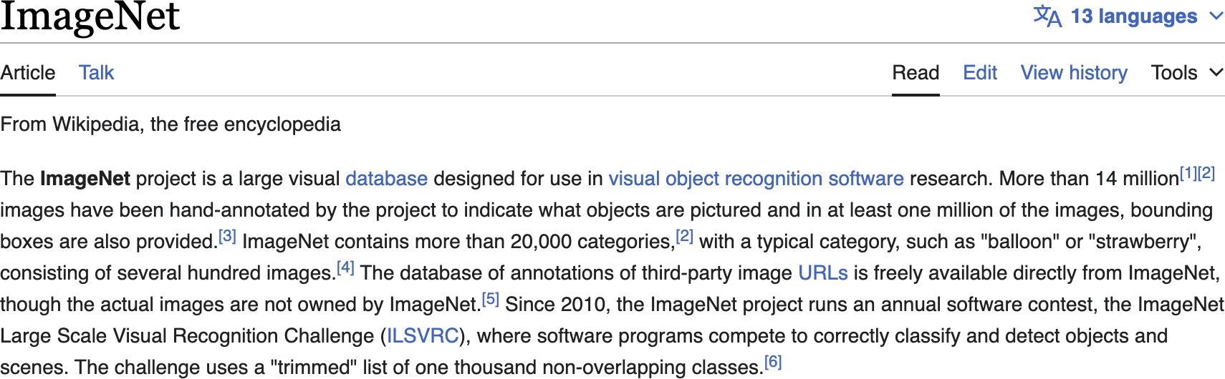
ImageNet
https://en.wikipedia.org/wiki/ImageNet

Slide 20

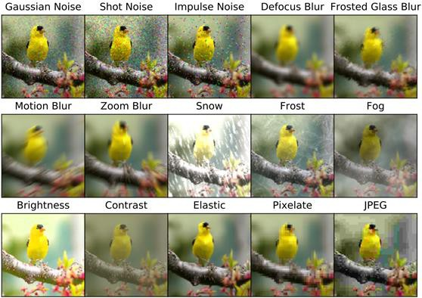
How Can We Test Robustness to Adverse Inputs?

Slide 21
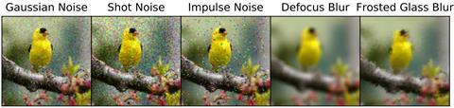
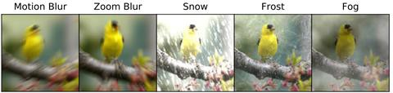
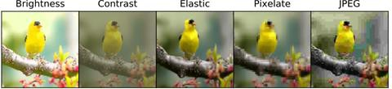
ImageNet-C [corruptions]
Train on ImageNet, test on
ImageNet-C
ResNet-50 gets 76% on
ImageNet
Residual Network, specific
type of CNN, 50 layers
45%
43%
42%
50%
42%
37%
37%
29%
37%
57%
70%
44%
56%
58%
66%

Slide 22
ImageNet-R [Rendition]
ImageNet: photos only, no painting, no drawings, etc.
ImageNet-Rendition is a style robustness test set with 30K images with
different texture and styles
Flickr images with query as “art,” “cartoons,” “graffiti,” “embroidery,” “graphics,” “origami,” “paintings,” “patterns,” “plastic objects,” “plush objects,” “sculptures,” “line drawings,” “tattoos,” “toys,” “video game,” and so on.
Train a model on normal ImageNet, and then test on ImageNet-R’s paintings, drawings, sculptures, ...

Slide 23
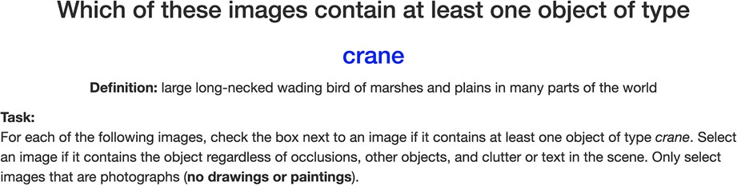
ImageNet-R is Disjoint from ImageNet

Slide 24
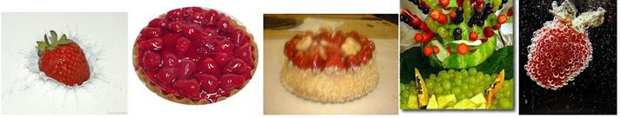
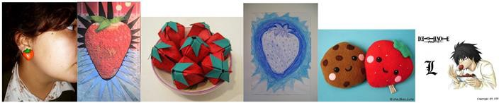
ImageNet-R [Rendition]
ImageNet
ImageNet-R

Slide 25
Mining for Hard Examples and Adversarial Filtration
A way to create a stress test for models is to collect examples that fool
an existing strong model (“natural adversarial examples”)
One can mine for hard examples by having a model classify a large set of examples and create a test set of the examples that it got wrong
Researchers sometimes collect egregious errors where models are
highly mistaken, such as high-confidence misclassifications

Slide 26
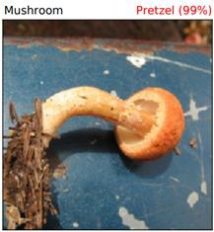
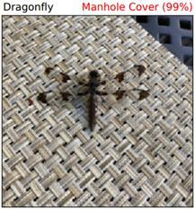
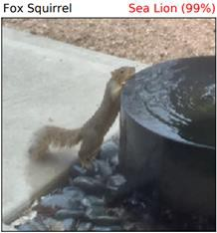
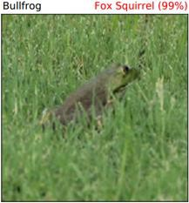
ImageNet-A [Adversarial]
ImageNet-Adversarial contains naturally occurring examples that are
difficult for ResNet-50 models to classify
These examples are difficult for other new models too, including Vision Transformers, which demonstrates shared weaknesses across architectures

Slide 27
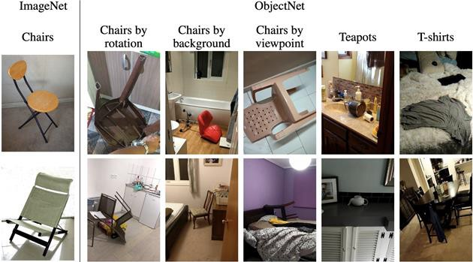
ObjectNet
Collected to show objects from new viewpoints on new backgrounds

Slide 28
ANLI
ANLI is an adversarial natural language inference (NLI) dataset
NLI is about determining whether a “hypothesis” is true, false, or undetermined given a “context”
The dataset is created by crowdworkers with the aim of fooling large- scale models
GPT-3 only gets up to ~40% accuracy

Slide 29
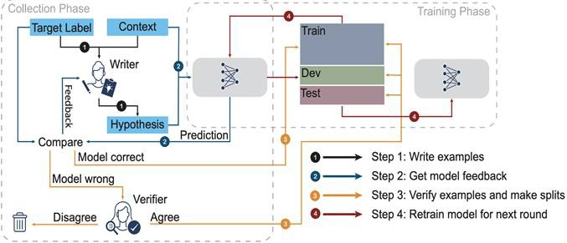
ANLI
An annotator writes a hypothesis. A model makes a prediction about the context-hypothesis pair. If the model’s prediction was correct, the annotator writes a new hypothesis. If the model was fooled, the context-hypothesis pair is validated by other annotators.

Slide 30
Unit 1 - Foundations and real-world risks
Improving Robustness

Slide 31
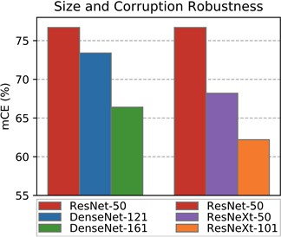
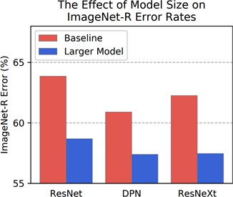
Large Models Improve Robustness
Models with more parameters generalize to unseen situations better
Larger models, more parameter, more redundancy in representations, one neuron fails, another pick up detect the feature detected by other neuron
ImageNet-C error, lower better

Slide 32
Studying Robustness: Data Augmentation Methods
MixUp
AutoAugment
AugMix
PIXMix
Cutout
CutMix
ImageNet-C style corruptions

Slide 33
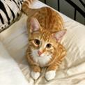
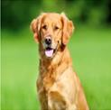
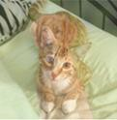

Mixup
Mixup augments the data by performing an elementwise convex combination on inputs and outputs
Mixup improves corruption
robustness
If and are audio signals, then mixup is just mixing the audio
https://en.wikipedia.org/wiki/Convex_combination

Slide 34
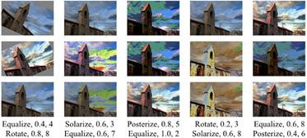
AutoAugment
AutoAugment proposes data augmentation strategies using diverse Python
Imaging Library augmentations such as Invert, Solarize, and so on
Example Augmentations
AutoAugment composes two augmentations together, each with two parameters:
a probability of being turned on and an intensity
They train tens of thousands of deep networks to search for a few augmentation
parameters, and they propose some of their best parameter settings

Slide 35
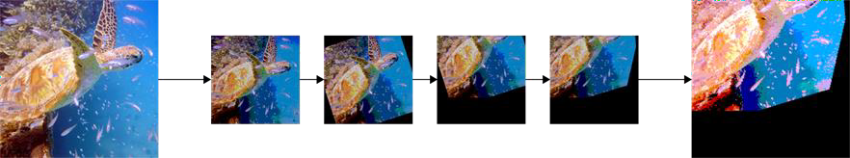
Random Augmentations
To avoid AutoAugment’s computational cost, we may want to use randomized augmentations. To achieve diverse, random augmentations we could combine many random augmentations together
However, uncontrolled random augmentations can make images start to become unrecognizable

Slide 36
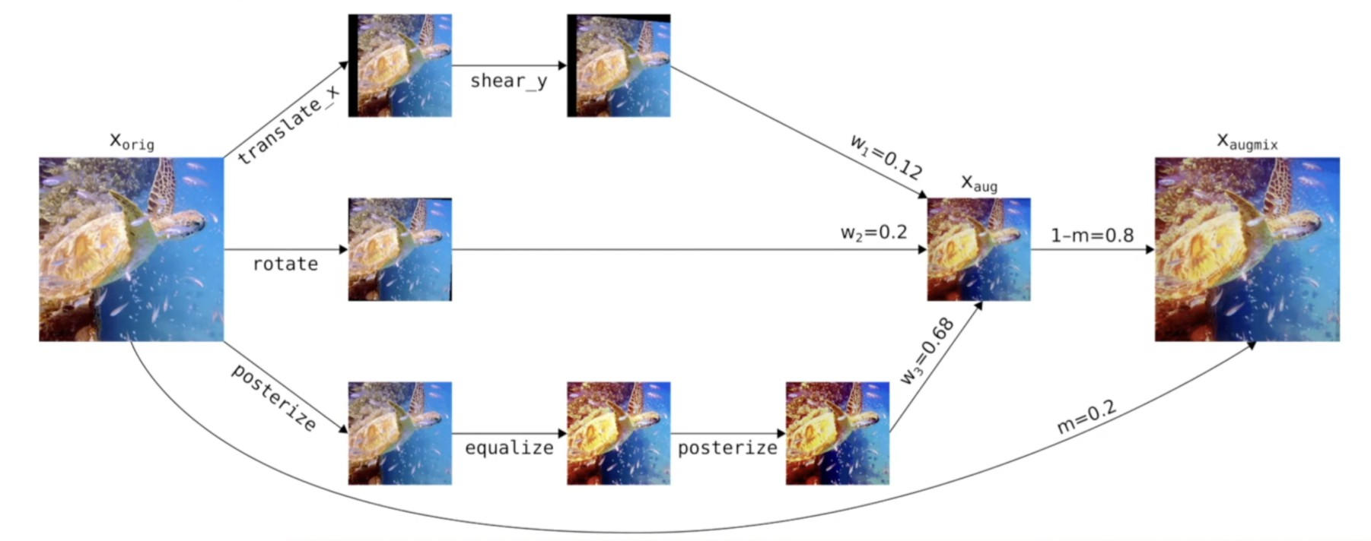
AugMix
Uses random augmentations and mixes these augmentations to keep
images recognizable
we randomly sample the operations, the intensity, the depth of each
branch, and all mixing weights.
Use only some augmentation
Different image transformation
Skip connection

Slide 37
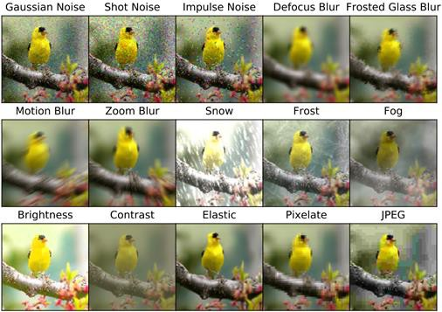
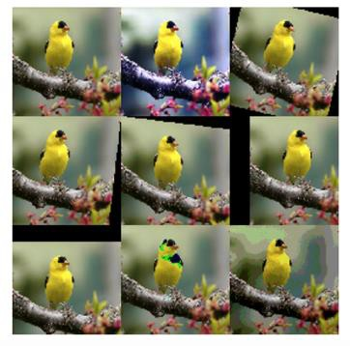
Avoiding Train-Test Overlap
ImageNet-C corruptions
operations used by AugMix

Slide 38
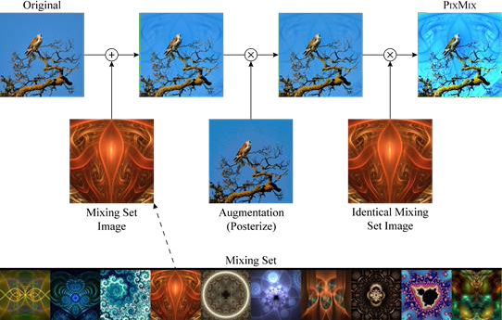
PixMix
PixMix mixes training images with images from another dataset
The bird training image is mixed with an image from a fractal dataset
Unlike mixup, the mixing set is not the original training set

Slide 39
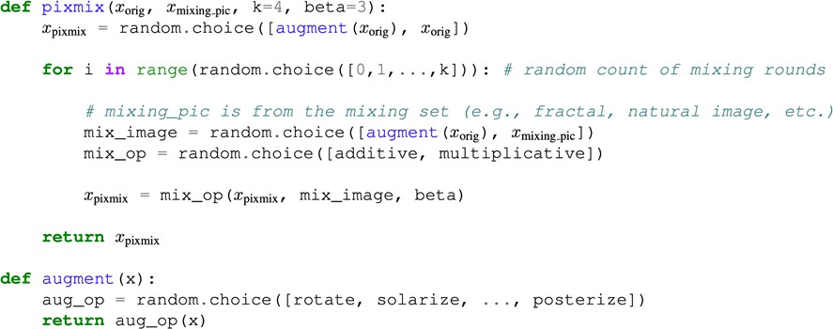
PixMix Pseudocode

Slide 40
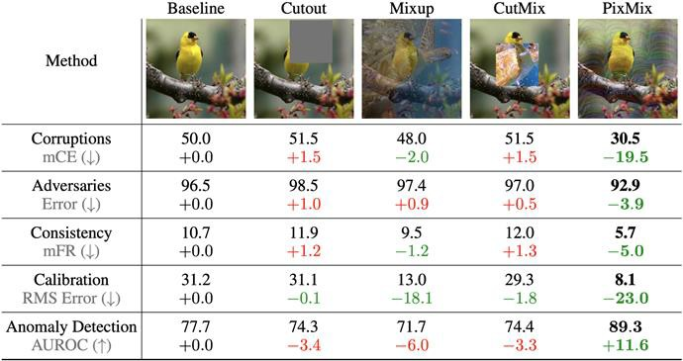
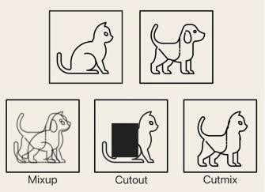
PixMix Evaluation
PixMix helps with robustness as well as other safety metrics

Slide 41
PixMix Evaluation
PixMix helps with robustness as well as other safety metrics
Note many of these methods do not improve typical accuracy.
They just improve safety metrics.

Slide 42
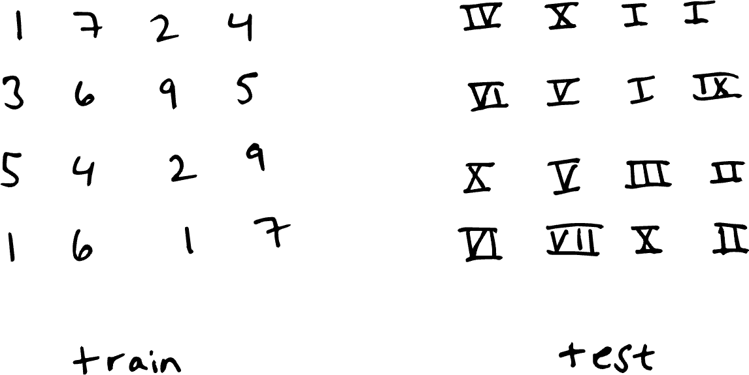
Distribution Shifts

Slide 43

Distribution Shifts
Occurs when the joint distribution of inputs and outputs differs
between training and test stages
This issue is present, to varying degrees, in nearly every practical ML application, in part because it is hard to perfectly reproduce testing conditions at training time.

Slide 44
Different types of distribution shifts: Covariate shift
Covariate Shift
Concept Shift
Prior probability shift / label shift

Slide 45
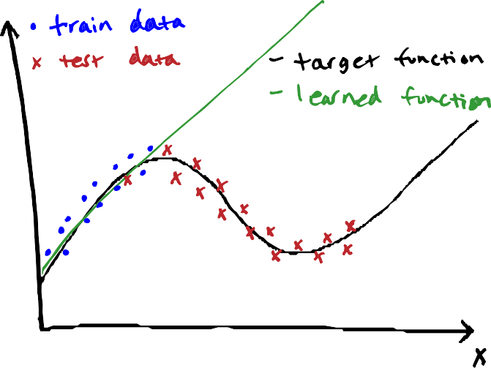
Covariate shift
P(x) changes between train and test, but
p(y|x) does not change
When the distribution of training data and test data differ significantly, a learned model can fit training data well but perform poorly on test data.
Driverless car – Sunny streets train – Snow test Speech recognition – native English speaking
train – test on all English speaking
Any other examples?

Slide 46
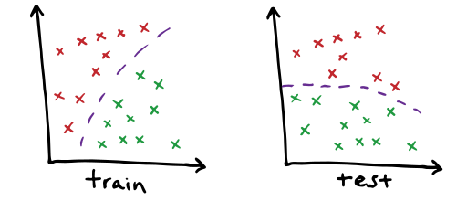
Concept shift

Slide 47
Concept shift
2 class dataset with 2 dimensional features Classes color coded in red & green, purple is the
decision boundary
Input distribution exactly same in train & test, but the relationship between them / decision boundary changes
Any examples?
Browsing history from pre-pandemic deployed in March 2020 for purchase recommendations. Any shifts?
Watching travel videos ➔ might buy plane / hotel
tickets, pay for nature documentary movies

Slide 48
Prior probability shift / label shift
Reverse of Covariance shift
Prior probability shift appears only in y ➔ x problems (when we believe y causes x). It occurs when p(y) changes between train and test, but p (x | y) does not.
Examples? Medical Diagnosis
Train on data to predict diagnoses given symptoms
Test on data during flu season where test(flu) > train(flu) while flu symptoms p(symptoms | flu) is still the same

Slide 49
Detecting distribution shift
Monitor the performance of your model. Monitor accuracy, precision, statistical measures, or other evaluation metrics. If these change over time, it may be due to distribution shift.
Monitor your data. You can detect data shift by comparing statistical properties of training data and data seen in a deployment.

Slide 50
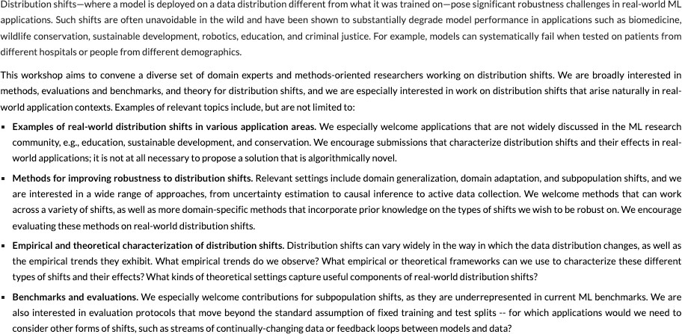

https://sites.google.com/view/distshift2023

Slide 51
Bibliography / Acknowledgements
https://course.mlsafety.org/ https://www.aisafetybook.com/

